Slide 1
Fastenex - Retention & Operational ROI
A Unified Command Center for Operational Excellence and Strategic Financial ROI
By Rohini

Slide 2
Problem statement – HR attrition analysis
Frequent employee exits which increases recruitment and training costs, loss of experienced talents and disruption in ongoing operations.
HR data (stored in multiple systems) masking critical workforce trends ---- unable to effectively monitor attrition pattern.
Lack of visibility which tends to reactive, rather than proactive in HR decisions.
Lack of employee segmentation and trend analysis-----limits the ability to identify high risk groups and implemented retention strategies.
Restricts the ability to enable deeper workforce analysis.

Slide 3
Solution & Dataset details
1.Finding the factors behind the attrition pattern by employee segmentation and trend analysis, storing all the HR data in one place.
2. Implementing retention strategies with privileges.
3. During night shift, workers will receive a 5% premium allowance calculated on weekly rate, applicable only for the week(s) worked on that shift.
Dataset collected using claude ai
Dataset has attributes like department, job role, age group, attrition status, burnout risk, shift type.

Slide 4
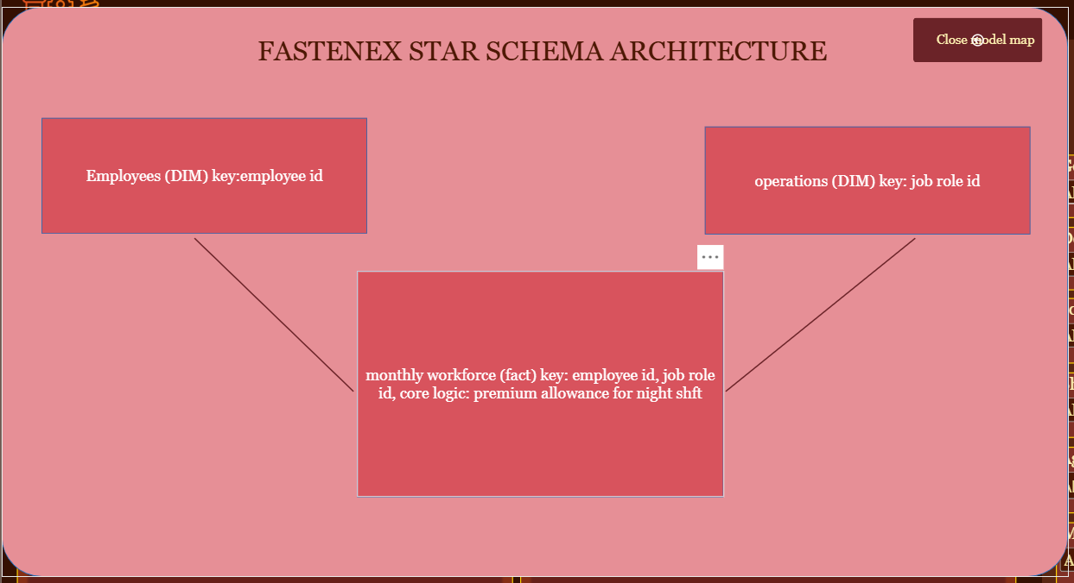
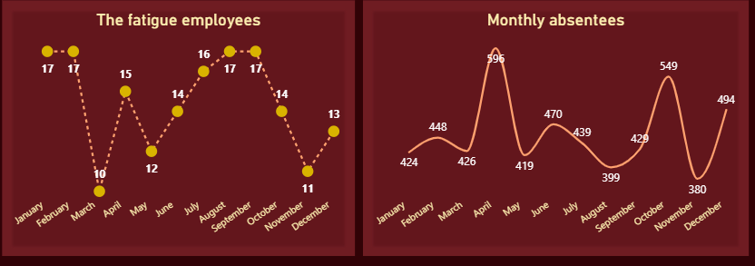
Unified Data Engine
The Challenge: Scattered HR logs and data silos masked critical operational problems.
Data Consolidation: Engineered a pipeline to store all historical HR logs and operational records in one centralized place.
Pattern Identification: Built a system to find the exact factors behind attrition through deep employee segmentation and trend analysis.
Star Schema Engine: Designed an optimized data model linking dim_employees and dim_operations to the core workforce facts.

Slide 5
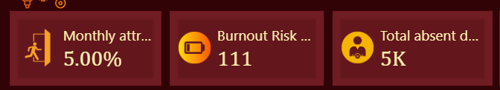
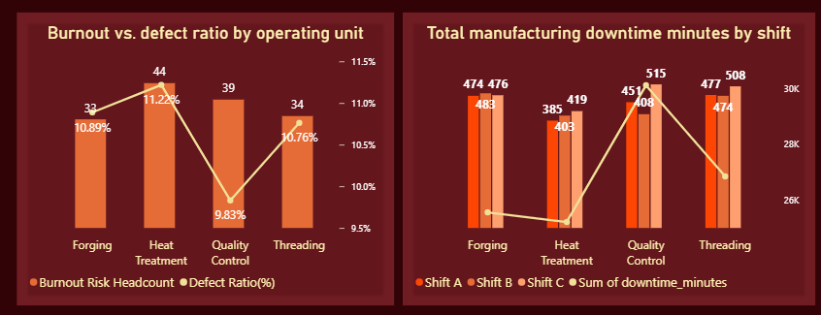
Finding the Bottlenecks
Severe Fatigue Status: Top KPI cards instantly isolate 111 employees operating under heavy burnout risk, leading to 5,000 lost absent days.
Cause & Effect: Directly modeled burnout scores against factory errors, proving that the Heat Treatment department suffered the highest risk (44 workers driving a peak 11.22% defect rate).
Downtime Visibility: Tracks manufacturing delay minutes across shifts to let shop-floor supervisors locate production line friction immediately.

Slide 6
The Fastenex employee retention framework
The Fastenex Employee Retention Framework
  Financial Stability: Streamlined bank loan approval pathways.
  Culture Booster: Birthday gift vouchers distributed to all staff.
  Family Care: Direct company contributions to children's education fees
  Health Security: Medical claim facilities up to 2 Lakhs extended to family members
  Tenure Growth: Structured career pathways for trainees hitting 2 years, paired with a company-funded yearly tour.

Slide 7
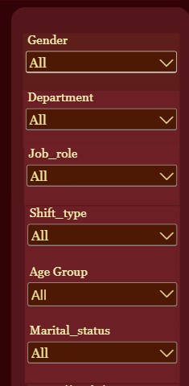
Balanced Operations & Night Shift Premiums
Dynamic Shift Rotation: Recommends that employees experience all operational shifts, balanced intelligently by their Age Group and Gender profile.
Weekly Premium Allowance: Workers on the night shift receive a 5% premium allowance calculated on their weekly rate.
Targeted Application: The extra payout applies strictly to the week(s) actively worked on that shift.
Financial Stability: Standard monthly salaries remain completely untouched during standard daytime operational weeks.

Slide 8
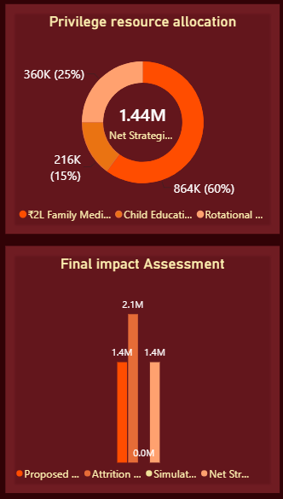
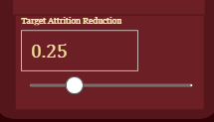
Strategic ROI Evaluation & Automatic Budget Splitting
Executive Simulator: Uses a custom DAX What-If parameter slider to simulate variable financial rescue metrics against the fixed $2.13M baseline Attrition Cost.
Flawless Axis Scaling: Integrated an advanced ABS() boundary logic measure to establish a rock-solid $1.44M Net Strategic ROI.
Dynamic Allocation: Deployed a filter-override measure (Dynamic Slice Value) to automatically split the rescued capital into targeted corporate actions:
  15% to Child Education Grants ($216K)
  25% to Rotational Shift Restructures ($360K)
  60% to Family Medical Coverage ($864K)

Slide 9
Bridging the Gap: Human Well-being to Corporate ROI
  End-to-End Success: Proves that programmatic data cleaning, star schema architecture, and single-screen analytics can solve severe operational problems.
  Data-Backed Strategy: Replaces intuition with interactive calculations, demonstrating that employee well-being is a massive corporate profit driver.
  Enterprise Scalability: The unified model is fully scalable, allowing the enterprise to inject new operational datasets seamlessly.
Thank you for your time. I am open to strategic questions.

